Slide 1
Time Response Specifications
The desired performance characteristics of a system of any order may be specified in terms of the transient response to a unit step function input.
The transient response of a practical control system may exhibit damped oscillations before reaching steady state. In specifying the transient response characteristics of a control system to a unit step input, we usually specify the following:
Delay time, td
Rise time, tr
Peak time, tp
Peak overshoot, Mp
Settling time, ts
Let us consider an under damped case.

Slide 2
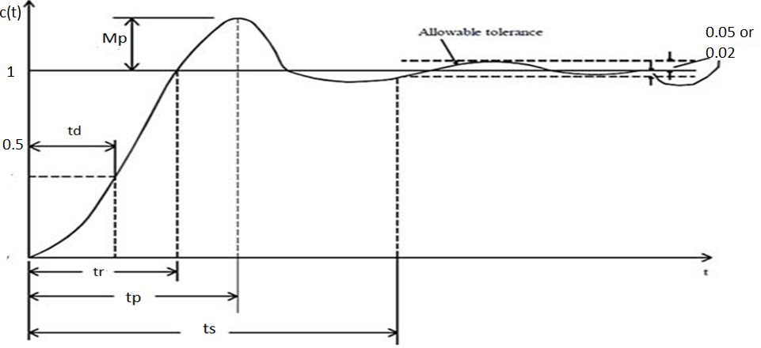
Contd….
Delay Time: Delay time is the time required for the response to reach 50 % of
the final value for the first very time..

Slide 3
Contd….
(ii) Rise Time ( t_{r}): The rise-time is defined as the time taken for the step response to go
from 10 % to 90 % of the final value. Usually, 10% to 90% is used for over damped
system and 0% to 100% is used for under damped system.
Note: Rise time can be be obtained by putting c(t) =1 at t = t_{r} in the equation
of c(t)

Slide 4
Contd….
(iii) Peak Time (t_{p} ): Peak time is the time required for the response to reach the first
peak overshoot.
Note: Peak time can be be obtained by differentiating c(t) with respect to
t and equating it to zero ( since the first derivative equals zero either at
Maxima or minima).
(iv) Peak ( Maximum) Overshoot (M_{p} ): The maximum overshoot is the
maximum peak value of the response curve from unity.

Slide 5
Contd….
Settling time (t_{s}): Settling time is the time taken for the step response to
decrease and stay within 2-5% of its final value.
The time constant of an exponential envelope of c(t) is given by
The time constant for 2 % tolerance band is usually 4 times the time constant
defined above

